Slide 1
Migration and EU citizenship: EU law and rights
EU citizenship was introduced by the Maastricht Treaty in 1992. EU citizens have certain rights
• The right of free movement, settlement and employment across
the EU
• The right to trade and transport goods, services, and capital
through EU borders as in their national markets
• The right to vote in and run as a candidate in local and EU
elections in the country in which they live
They are protected by EU law and the ECJ. Specifically the Charter of Fundamental Rights of the EU covering ‘Dignity’, ‘Freedoms’, ‘Equality’, ‘Solidarity’, ‘Citizens’ Rights’, and ‘Justice’

Slide 2
EU immigration into the UK: the recent record
LSE Centre for Economic Performance, Brexit Analysis No. 5.
Between 1995 and 2015, the number of immigrants from other European Union (EU) countries living in the UK tripled from 0.9 million to 3.3 million
In 2015, EU net immigration to the UK was 172,000, only just below the figure of 191,000 for non-EU immigrants.
The big increase in EU immigration occurred after the ‘A8’ East European countries joined in 2004.
The then Labour government decided not to opt for transitional controls on immigration from the A8 countries
The Czech Republic, Estonia, Hungary, Latvia, Lithuania, Poland, Slovakia and Slovenia

Slide 3
LSE Centre for Economic Performance, Brexit Analysis No. 5.
In 2016, immigration to Britain reached 650,000 – its highest ever annual level – including record numbers of European migrants
Net migration remained at a near-record high of 335,000 in the 12 months to the end of June 2016
2016 – a historically high inflow of 284,000 EU citizens. Note the number of those from outside Europe (289,000)

Slide 4
LSE Centre for Economic Performance, Brexit Analysis No. 5.
About a third of EU immigrants live in London, compared with only 11% of the UK-born.
EU immigrants are more educated and younger than the UK-born. About 44% have some form of higher education compared with only 23% of the UK-born.
EU immigrants are more likely to be in work and less likely to claim benefits than the UK-born

Slide 5
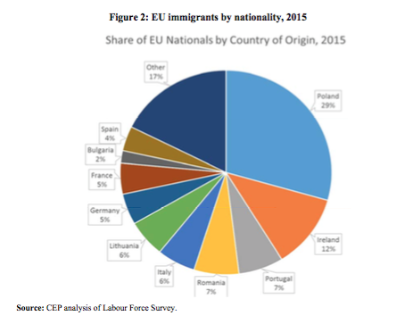

Slide 6
LSE Centre for Economic Performance, Brexit Analysis No. 5.
Does immigration reduce the pay and job chances of UK- born people because of more competition for jobs?
Maybe, but immigrants consume goods and services and this increased demand helps to increase demand for labour
Increased demand for labour is a positive influence on pay
Immigrants also pay taxes that help fund more public goods and services – also increasing demand for labour
Immigrants also might have skills that complement UK-born workers rather than compete with them.
We need empirical evidence to settle the issue

Slide 7
LSE Centre for Economic Performance, Brexit Analysis No. 5.
The areas of the UK with large increases in EU immigration did not suffer greater falls in the jobs and pay of UK-born workers than those with lower increases in immigration.
Changes in wages and joblessness for less educated UK- born workers show little correlation with changes in EU immigration.
So there’s little effect of EU immigration on inequality through reducing the pay and jobs of less skilled UK workers.
The big falls in wages after 2008 are due to the global financial crisis and a weak economic recovery, not to immigration.

Slide 8
LSE Centre for Economic Performance, Brexit Analysis No. 5.
EU immigrants pay more in taxes than they take out in welfare and the use of public services.
Immigrants do not have a negative effect on local services such as crime, education, health, or social housing
The refugee crisis has nothing to do with EU membership.
The UK is not in the Schengen passport-free travel agreement so there are border checks on refugee migrants.
So refugees admitted to other EU countries have no right to live in the UK.

Slide 9
LSE Centre for Economic Performance, Brexit Analysis No. 5.
CEP shows that immigration isn’t associated with reductions in pay for low–paid and unskilled workers
In these areas, or in certain trades within them, pay and employment is unlikely to fall – precisely because demand for labour is relatively high?
It compares % changes in low pay with % changes in immigration across all local authorities between 2008 and 2015
But the influx of migrants may have prevented or helped to slow pay rises in these areas and trades?
Not entirely convincing: there’s a national UK market for labour rather than a series of unconnected local markets.
This doesn’t affect the point that, overall, immigrants tend to increase employment and pay because they buy goods and services, and pay disproportionately more taxes than the average UK–born person
Immigrants, especially, will tend go where there are jobs to be had – where the demand for labour is relatively high?
Note the complex of factors that influence pay levels……

Slide 10
The important issues in the EU referendum for leave voters

Slide 11
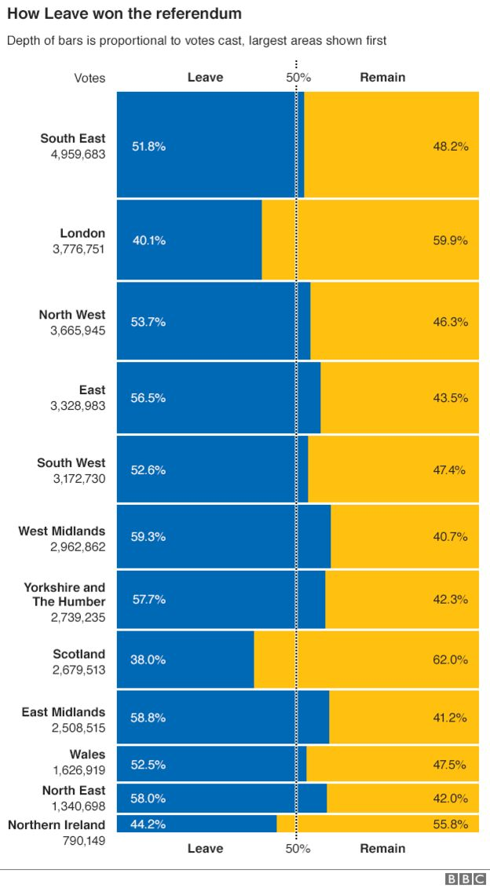
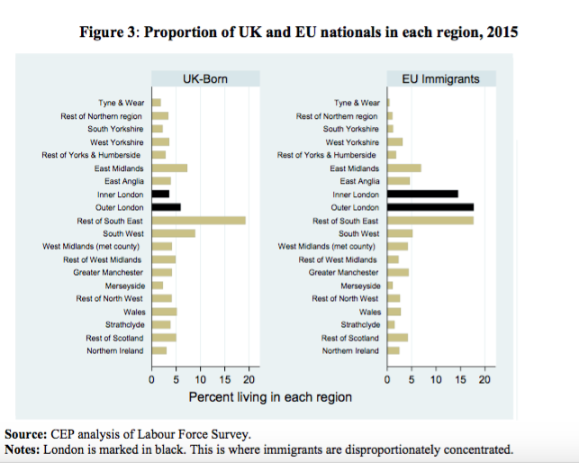
Location of immigrants compared with voting in the EU referendum

