Slide 1
Lucy Finchett-Maddock Free University Brighton
HUMAN RIGHTS
AND EQUALITY

Slide 2
Intended Learning Outcomes
What are human rights?
What is equality?
Concepts of equality within Human Rights
UDHR and Inequality
ECHR, ECtHR and Equality
HRA 1998 and Equality
Public Bodies, HR and Equality
HR and Equality Act 2010
Equality and Human Rights Commission

Slide 3
Human Rights

Slide 4
What are human rights?
Basic conception
Who protects human rights?
Did they exist before being made legal?
Good or bad?
Human rights as human wrongs?
Some people have more rights than others?

Slide 5
What is Equality?
Formal v substantive

Slide 6
Concepts of Equality and Human Rights
Are they one and the same thing?
Both based on the liberal conception of individual rights

Slide 7
The Protector of the State
Equality
Rights
State

Slide 8
Domestic v International Rights
Equal rights among fellow citizens or equal rights among fellow human beings?
Human rights therefore as universal
Cosmopolitan egalitarian ideal of justice

Slide 9
Question of Immigration

Slide 10
Minimal, International Norms
Conventional human rights norms specify a standard that is in some important sense minimal
“Human rights norms specify standards of transnational justice, minimal conditions that a just international order would require every state to meet in its treatment of human beings, both domestically and abroad” (Buchanan, 2005) .

Slide 11
Subject-Centred Inherent Dignity
Expression in two of the most important rights conventions:
Universal Declaration of Human Rights
International Covenant on Civil and Political Rights (ICCPR)
‘inherent dignity’ of each human being.

Slide 12
Minimalism and Assurance
Jeremy Waldron - Assurance means that everyone should feel secure in that he or she has “an elementary entitlement to justice, and [that] all deserve protection from the most egregious forms of violence, exclusion, indignity and subordination” (Waldron, The Harm in Hate Speech (2012), p.83.)

Slide 13
Common law – habeas corpus
Public law – judicial review
Criminal law
Anti-discrimination legislation
Human rights law
= secure equal respect for some of the most elementary entitlements to justice that everyone should be assured about.

Slide 14
Human Rights, Justice and Injustice
How does it feel to experience injustice?
Can you think of an example?
What do you seek to do?
World Wars
Protest
End to Impunity

Slide 15
Human Rights Law
Where does the legality of human rights come from?
International
Regional
National

Slide 16
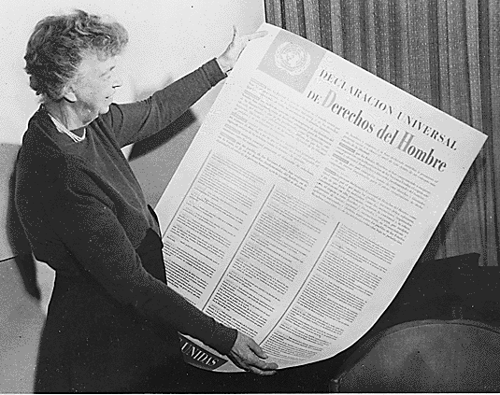
Universal Declaration of Human Rights (UDHR) 1948
All human beings are born with equal and inalienable rights and fundamental freedoms
Inherent dignity

Slide 17
An Era of Cooperation
European Convention of Human Rights (ECHR) 1950 – British lawyers and Churchill very influential
Established by the newly formed Council of Europe 1947
Council of Europe and EC borne out of an era of cooperation
Victorious powers of the World Wars – Great Britain, France, US
European Court of Human Rights (ECtHR) established 1959 (UK only accepted right to individual petition 1966)

Slide 18
Cosmopolitanism and HR
Socrates - “I am not an Athenian or a Greek, but a citizen of the world." [As quoted in Plutarch's Of Banishment]
Kant’s Perpetual Peace
Tolerance and hospitality (Derrida)

Slide 19
ECHR, ECtHR and Equality Jurisprudence
United Nations (1945) following from League of Nations (1920)
International Human Rights Law Treaties and Courts – e.g. International Covenant on Civil and Political Rights (ICCPR); International Criminal Court (ICC)
Regional Human Rights Law – e.g. Inter-American Court of Human Rights (IACHR); African Charter
National Human Rights Law – e.g. HRA 1998

Slide 20
Relevant ECHR Articles
Article 3 – freedom from torture
Article 5 – right to liberty and security
Article 6 – right to a fair trial
Article 8 – right to private and family life
Article 9 – freedom of thought, conscience and religion
Article 10 – right to freedom of expression
Article 11 – right to freedom of assembly
Article 12 – right to marry
Art 2, Protocol 1 – parental rights in education

Slide 21
Prohibition of Discrimination - Article 14 ECHR
The enjoyment of the rights and freedoms set forth in this Convention shall be secured without discrimination on any ground such as sex, race, colour, language, religion, political or other opinion, national or social origin, association with a national minority, property, birth or other status.
Only used when another right is engaged.

Slide 22
Protected Characteristics Equality Act 2010 s4 as:
Age – art. 14;
Disability – art. 14;
Gender reassignment – art. 8;
Marriage and civil partnership – art. 12;
Pregnancy and maternity – art. 14;
Race – art. 14;
Religion or belief – art. 9;
Sex – art. 14;
Sexual orientation – art. 8.

Slide 23
Absolute and Non-Absolute Rights
ABSOLUTE RIGHTS (non-derogable) | NON-ABSOLUTE RIGHTS (derogable)
Article 2: The right to life Article 3: The right not to be tortured or treated in an inhuman or degrading way Article 4 (1) The right to be free from slavery Article 7: No punishment without law | Article 4 (2): The right to be free from forced labour Article 5: The right to liberty (limited) Article 6: The right to a fair trial Article 8: The right to respect for private and family life, home and correspondence (qualified) Article 9: The right to freedom of thought, conscience and religion (qualified) Article 10: The right to freedom of expression (qualified) Article 11: The right to freedom of assembly and association (qualified) Article 12: The right to marry and found a family Article 14: Prohibition on Discrimination Article 1, Protocol 1: The right to peaceful enjoyment of possessions (qualified) Article 2, Protocol 2: The right to education(qualified) Article 3, Protocol 2: The right to free and fair elections

Slide 24
Positive and Negative Rights
Civil and Political Rights – negative duty on the state e.g. ‘freedom from’ (torture, slavery etc.)
Social and Economic Rights – positive duty on the state e.g. housing, education etc.

Slide 25
Autonomy and Proportionality
Autonomy – self-legislation
Auto – self
Nomos – law
We are free to govern ourselves – liberty
But always in relation to others (qualified rights)
Liberty and equality
Substantive justice

Slide 26
Religious Equality
Campbell v United Kingdom (No.2) (1982) 4 E.H.R.R. 293 at [36]. - The Convention protects all religions unless they are incompatible with human dignity, and therefore not worthy of respect in a democratic society – ‘philosophical considerations’
Campbell – use of corporal punishment in Scottish schools

Slide 27
Article 9(1) of the ECHR
Notably, the ECHR offers absolute protection only towards the right to believe, or change one’s beliefs.

Slide 28
Article 9(2) of the ECHR
Freedom of manifestation "through worship, teaching, practice and observance" is subject to restrictions provided that they pursue a legitimate aim and that they are necessary in a democratic society.

Slide 29
Secularism v Pluralism

Slide 30
Religious Rights in the Workplace
Eweida and Chaplin v. the United Kingdom and Ladele and McFarlane v. the United Kingdom.

Slide 31
Eweida and Chaplin were both prevented by their employers’ dress codes from wearing a visible cross/crucifix when in uniform at work.
The majority of the European Court of Human Rights decided that their religious rights at work needed to be balanced against other considerations.

Slide 32
Eweida
In the case of Eweida - airline check-in officer, they found that her Article 9 right to manifest her belief was unjustifiably breached.
Domestic courts gave too much weight to the employer's legitimate need to project a corporate image and not enough weight to the employee's right to wear a visible cross.

Slide 33
Chaplin
Chaplin, a nurse wearing a cross - the Court unanimously concluded - health and safety of staff and patients outweighed the right of the employee to wear a visible crucifix on a chain around her neck.
The employer's decision interfered with her Article 9 rights, but it was justifiable on health and safety grounds.

Slide 34
Appeal to ECtHR from London Borough of Islington v Ladele [2009] EWCA Civ 1357 & McFarlane v Relate Avon Ltd [2009] UKEAT
Ladele and McFarlane both objected, due to their religious beliefs about marriage and sexual relationships, to carrying out certain work duties in respect of same-sex couples.
The European Court of Human Rights found against both of them.
When one convention right has to be balanced against another - proportionality

Slide 35
Are Convention rights enough?
What about children’s rights, socio-economic rights, language rights?
Should the Convention on the Rights of the Child (UNCRC) and the International Covenant of Economic, Social and Cultural rights (ICESCR) be incorporated into domestic law?
Is there a case for a UK or British Bill of Rights? More rights, fewer rights, or simply less ‘European’ rights?
And what about the rights of illegal migrants and criminals? Don’t they have rights too?

Slide 36
Rights to all Citizens
v
Equal Rights of all Humans

Slide 37
ECHR a charter for ‘illegal migrants and criminals’ or an instrument that protects minorities and the most marginalised/vulnerable in society? See Bringing Rights Home, Deborah Singer http://www.youtube.com/watch?v=8vicTYgIEhQ (Feb 2013).

Slide 38
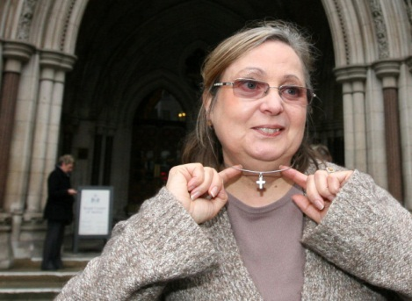
Or a charter for minorities?
Eweida and Others v UK, Application Nos. 48420/10, 59842/10, 51671/10 and 36516/10), 15 January 2013, ECtHR

Slide 39
Universal?
Western understanding of the world v universal application?
Neo-colonialism - Human Rights, Democracy, Rule of Law used as an excuse to invade ‘Iraq’

Slide 40
Human Rights Act (HRA) 1998

Slide 41
Section 1 – brings Convention rights (articles of ECHR) home (set out in Schedule 1)
Section 3 – all law to be read in accordance with convention rights (legislators and judges)
Section 4 – declaration of incompatability

Slide 42
Council of Europe
European Convention on Human Rights
Human Rights Act 1998
EU
EU Law
European Communities Act 1973

Slide 43
What authority does Strasbourg have?
UK bound to comply with judgments as matter of international law, but under domestic law Parliamentary sovereignty prevails?
What about UK courts?
S. 2(1) HRA: ‘A court or tribunal determining a question which has arisen in connection with a Convention right must take into account any - (a) judgment, decision, declaration or advisory opinion of the European Court of Human Rights … whenever made or given, so far as, in the opinion of the court or tribunal, it is relevant to the proceedings in which that question has arisen.’

Slide 44
Strasbourg v UK: Prisoners’ Voting Rights
Hirst (No 2) v UK, ECtHR, 6 October 2005 – GC- voting ban applied automatically to all prisoners and therefore fell outside the State’s margin of appreciation, violation of Art 3 of Protocol 1 (right to free elections)
R (on the application of Chester) V Secretary of State for Justice [2013] UKSC 63 – no point in further declaration of incompatibility under s. 4 HRA (following Smith v Scott ) or entering into constructive dialogue with Strasbourg,
Up to parliament

Slide 45
Is there a wider political agenda?
Does the HRA give too much power to the judges? To Strasbourg?
Brexit??
Should rights be linked to behaving responsibly? Do prisoners, for example, have the right to have rights?
What do you think?

Slide 46
State, Rights, Equality

Slide 47
HRA 1998: What impact has it had?
What are the implications for public authorities, and for courts?
To what extent can it be used in cases against private individuals?

Slide 48
The HRA and Public Authorities
s 6 Human Rights Act 1998
“Public authority” includes -
(a) a court or tribunal and
(b)any person certain of whose functions are functions of a public nature,
- does not include either House of Parliament or a person exercising functions in connection with proceedings in Parliament.

Slide 49
As a ‘sword’ and a ‘shield’
s 7 Human Rights Act 1998
(1) A person who claims that a public authority has acted (or proposes to act) in a way which is made unlawful by section 6(1) may -
(a) bring proceedings against the authority under this Act in the appropriate court or tribunal …
(b) rely on the Convention right or rights concerned in any legal proceedings, but only if he is (or would be) a victim of the unlawful act.

Slide 50
Core and Hybrid Public Bodies
Aston Cantlow and Wilmcote with Billesley Parochial Church Council v Wallbank [2003] UKHL 37, [2004] 1 AC 546 - (core and hybrid)
“Factors to be taken into account include the extent to which in carrying out the relevant function the body is publicly funded, or is exercising statutory powers, or is taking the place of central government or local authorities, or is providing a public service."

Slide 51
What about care services?
YL v Birmingham City Council and others [2007] UKHL, [2008] 1 AC 95– a private care home providing care and accommodation for an elderly person under contract with a local authority was not exercising “functions of a public nature” within s 6(3)(b) of the Human Rights Act 1998
Social Care Act 2008, s. 145 - (section 145). those whose care provided under National Assistance Act 1948 now covered under s. 6.
Care Bill [HL] 2013-14

Slide 52
Article 8 & Private Bodies
Malik -v- Fassenfelt [2013] EWCA Civ 798, 3 July 2013 – Grow Heathrow
Court of Appeal accepted that Article 8 could apply in a case involving a private landowner (since the court itself is a public body that has to have regard to the Convention). That said, it is clear that an Article 8 defence would only defeat a claim brought by a private landowner in the rarest of cases.

Slide 53
Religious Minorities
R. (on the application of Begum) v Denbigh High School Governors [2006] UKHL 15; [2007] 1 A.C. 100 –
The refusal by a school to allow a pupil to wear a jilbab at school did not interfere with her right to manifest her religious beliefs under Article 9
No violation of Article 2 of the First Protocol to the Convention.
Rights engaged however

Slide 54
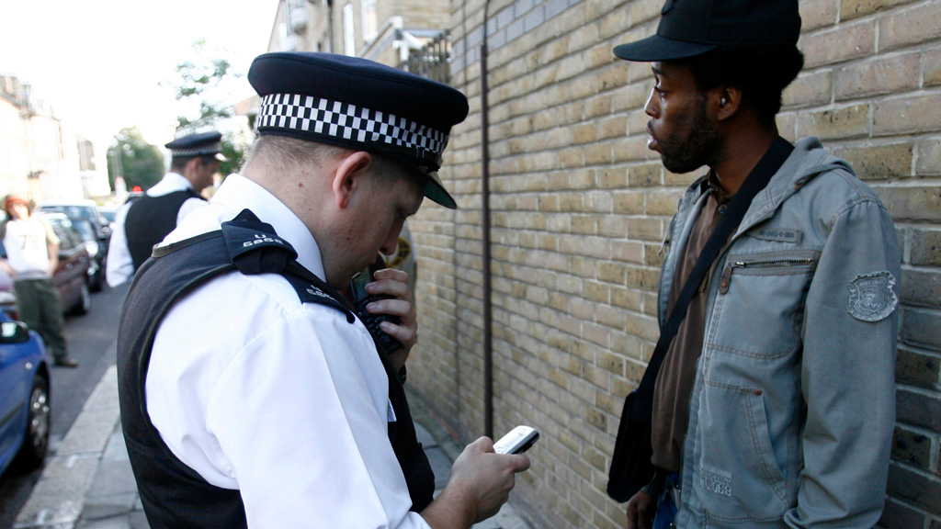
Racial Discrimination
No violation of Art 14 with Art 8 in relation to stop and search: R. (on the application of Roberts) v Commissioner of Police of the Metropolis [2014] EWCA Civ 69

Slide 55
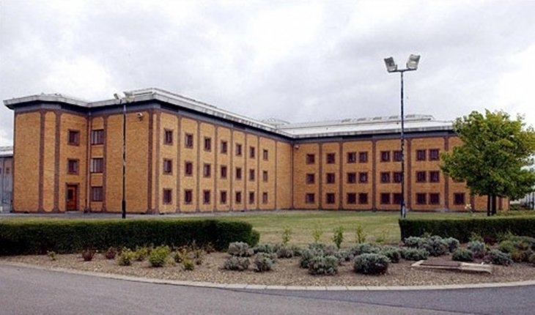
Foreign Nationals
Belmarsh Case - A & Others – art 14, art 5 (right to liberty and security), in definite detention of foreign nationals without trial – deportation where they could face torture (art 3 engaged) under s 23 Terrorism Act 2003
Brought in control orders – levelling down!

Slide 56
Some
people more equal
than others?

Slide 57
Equality and Human Rights Commission (EHRC)
Established Equality Act 2006
Promoting and understanding of the importance of equality and human rights
Independent Arms Length Body (ALB).
Negative Duty - upholding people’s rights, valuing diversity and challenging intolerance.
Positive Duty - identifying and tackling areas where there is still unfair discrimination or where human rights are not being respected.

Slide 58
Thank You ☺

