Slide 1
Critical Analysis of the Media
John Medhurst (johnme@pcs.org.uk)

Slide 2
“The Propaganda Model”
“You cannot hope to bribe or twist, Thank God! the British journalist But, seeing what the man will do unbribed, there's no occasion to”
Humbert Wolfe

Slide 3
“The Propaganda Model”
The five “filters”
Ownership
Advertising
Sources
“Flak”
“Enemies”

Slide 4
Who owns the British Media?
News International – The Sun, The News of the World, The Times, The Sunday Times, BskyB
Daily Mail & General Trust – The Daily Mail, Mail on Sunday, Metro, shares in ITN
Richard Desmond – Channel 5, Daily Express, Daily Star

Slide 5
Who owns the U.S Media?
General Electric (2009 revenue $157bn): NBC, Universal Pictures, Bravo etc
Disney (2009 revenue $36bn): ABC, ESPN, 277 radio stations
News Corp (2009 revenue $30bn): Fox News, Wall St Journal, New York Pos, 20th Century Fox
Time Warner (2009 revenue $25bn): CNN, TNT, AoL, Warner Bros, 150 magazines)
CBS (2009 revenue $13bn): CBS News, 30 TV stations, 130 radio stations)

Slide 6
“Air America” radio
Advertising boycott by
Bank of America
Coke
Epson
Exxon Mobil
FedEx
Gillette
Goodyear
Levis
McDonalds
Pepsi
Visa
Wal-Mart
Toys R Us

Slide 7
Glasgow University Media Group
Bad News
More Bad News
Bad News from Israel
“The Glasgow Group have got their hands dirty with a nuts-and-bolts dismantling of the manufacture of consent, taking apart news coverage image by image, word by word. There are no Thought Police in the modern democracy, but Big Brother exists just the same, dispersed in the minds of self-censoring broadcasters and journalists”
The Scotsman

Slide 8
Glasgow University Media Group
Demonisation of trade unions
Negative and dismissive language – “Trade Union Barons”, “wreckers”, “dinosaurs” etc - routinely used to describe trade union leaders and activists.
This continues today – e.g. The Sun’s front page headline reference to BA strikers as “Bloody Activists”.

Slide 9
PCS General Secretary Mark Serwotka
“Militant”
“Extreme left”
“Far Left”
“Firebrand union leader”
“2nd most dangerous man in Britain...”

Slide 10
Media subservience to power
Selection of headline stories, order of discussion
Coded language
Inclusion (or exclusion) of specific interviewees.
Unstated assumptions, implicit values.
Editorial decisions reflect and promote a particular view of the word and a particular set of (mostly) conformist values.

Slide 11
Who rises to the top?
“I don't say you're self-censoring - I'm sure you believe everything you're saying; but what I'm saying is, if you believed something different, you wouldn't be sitting where you're sitting”.
Noam Chomsky to Andrew Marr

Slide 12
“The Spectrum of Acceptable Opinion”
“The smart way to keep people passive and obedient is to strictly limit the spectrum of acceptable opinion, but allow very lively debate within that spectrum - even encourage the more critical and dissident views. That gives people the sense that there's free thinking going on, while all the time the presuppositions of the system are being reinforced by the limits put on the range of the debate”.
Noam Chomsky

Slide 13
Two political scandals: Watergate and COINTELPRO
Watergate - minor burglary , wiretapping of Democratic Party, cover up.
COINTELPRO – suppression of legal organisations (Black Panthers, AIM), sabotage, false imprisonment, assassination of political dissidents by FBI

Slide 14
Gary Webb & “Dark Alliances”
“In 17 years of doing this nothing bad had happened to me. I was never fired or threatened with dismissal if I kept looking under rocks. I was winning awards, getting raises, lecturing college classes, appearing on TV. So how could I possibly agree with people like Chomsky that the system didn’t work, that it was steered by powerful special interests? The system worked just fine as far as I could tell.”
Gary Webb, San Jose Mercury News, 2002

Slide 15
Gary Webb & “Dark Alliances”
“And then I wrote some stories that made me realise how sadly misplaced my bliss had been. The reason I’d enjoyed such smooth sailing for so long wasn’t that I was careful and diligent and good at my job. The truth was that, in all those years, I had never written anything important enough to suppress”.
Gary Webb

Slide 16
Gary Webb & “Dark Alliances”
In 1996 “Dark Alliances” revealed –
U.S backed terrorist army Nicaraguan “Contras” had sold crack cocaine to Los Angeles’ biggest crack dealer.
Direct contact between drug traffickers and CIA agents
US government knew about this and did nothing.
This traffic responsible for explosion of crack in Los Angeles black community

Slide 17
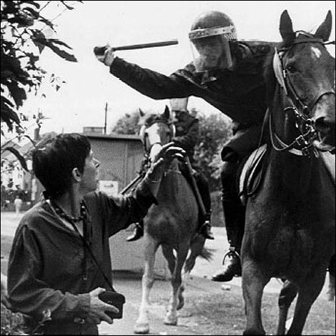
What is “News”?

Slide 18
What is News?
The Public Sector Pension “crisis” -
Public Sector Pensions - £4.8 billion per annum
Tax Relief for top 1% of earners - £10 billion.

Slide 19
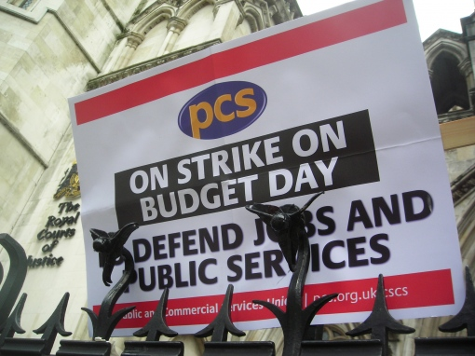
“What is News?”

Slide 20
“Intellectual Self-Defence”
Medialens
http://www.medialens.org/
Spinwatch
http://www.spinwatch.org/
John Pilger
http://www.johnpilger.com/
Mark Thomas
http://www.markthomasinfo.com
Undercurrents -
http://www.undercurrents.org/index.htm

Slide 21
“Intellectual Self-Defence”
Media Control – Noam Chomsky
Manufacturing Consent – Noam Chomsky
Hidden Agendas – John Pilger
Flat Earth News - Nick Davies
Guardians of Power: The Myth of the Liberal Media – David Edwards, David Cromwell
Newspeak in the 21st Century - Edwards & Cromwell
The Shock Doctrine - Naomi Klein

